Slide 1

21ECSC210
Exploratory Data Analysis Course Project: Phase - I Review
Covid-19 Statewise Vaccine Analysis
Department of Computer Science and Engineering,
KLE Technological University’s Dr. M. S. Sheshgiri College of Engineering and Technology, Belagavi

Slide 2
Details of the Team
Div: |  | B
Sl. No. | Name |  | SRN.
1 | Akhilesh joshi |  | 02FE22BCS013
2 | Dilipsingh Rajpurohit |  | 02FE22BCS035
3 | Sana Mulla |  | 02FE22BCS099
4 | Seeba Doddmani |  | 02FE22BCS116
Department of Computer Science and Engineering,
KLE Technological University’s Dr. M. S. Sheshgiri College of Engineering and Technology, Belagavi

Slide 3


Background
Coronaviruses, a diverse group of viruses, can lead to illnesses in both animals and humans. In humans, these viruses can cause a range of respiratory infections, from mild colds to more serious conditions like Middle East Respiratory Syndrome (MERS) and Severe Acute Respiratory Syndrome (SARS). The newest addition to this family of viruses is the one responsible for the COVID-19 disease, as identified by the World Health Organization.
Department of Computer Science and Engineering,
KLE Technological University’s Dr. M. S. Sheshgiri College of Engineering and Technology, Belagavi

Slide 4
Motivation: Target 3.8: Achieve universal health coverage, including financial risk protection, access to quality essential health-care services, and access to safe, effective, quality, and affordable essential medicines and vaccines for all. Relevance to COVID-19 Vaccine Analysis: The analysis of COVID-19 vaccine distribution aligns with SDG 3.8 by evaluating access to essential vaccines. Understanding regional disparities helps identify gaps in universal health coverage. Insights from the analysis can guide strategies to improve vaccine deployment and healthcare services, promoting well-being and health equity.
Sustainable Development Goal (SDG) 3: Ensure healthy lives and promote well-being for all at all ages.
Department of Computer Science and Engineering,
KLE Technological University’s Dr. M. S. Sheshgiri College of Engineering and Technology, Belagavi

Slide 5
Problem Statement and Objective
- Problem Statement Analyze the distribution and administration of COVID-19 vaccines across different states in India - Objectives We aim to uncover regional disparities, assess vaccination rates, understand demographic trends, address challenges, and predict future vaccine needs. By doing so, the project aims to provide actionable insights to optimize vaccine deployment strategies and combat the pandemic effectively.
Department of Computer Science and Engineering,
KLE Technological University’s Dr. M. S. Sheshgiri College of Engineering and Technology, Belagavi

Slide 6
Dataset Details
The number of new cases are increasing day by day around the world. This dataset has information from the states and union territories of India at daily level.
Vaccination data comes from covid19india.
There are 7845 instances, ranges from 0 to 7844.
Source URL : dataset19 [ appeared on Kaggle ]
The data was recorded from 16th January 2021 to
12th August 2021
Memory Usage = 1.4+ MB
Department of Computer Science and Engineering,
KLE Technological University’s Dr. M. S. Sheshgiri College of Engineering and Technology, Belagavi

Slide 7
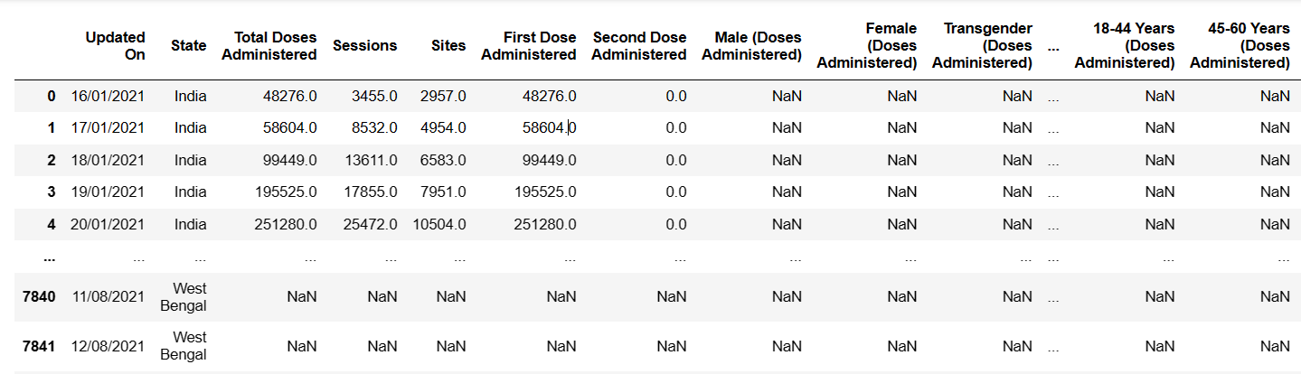
Snapshot of Dataset
7845 x 24
Department of Computer Science and Engineering,
KLE Technological University’s Dr. M. S. Sheshgiri College of Engineering and Technology, Belagavi

Slide 8
Knowing the Dataset
There are 24 features in the dataset.
Updated On : Date on which the data is recorded
State : Name of the region
Total Doses Administered : Total number of vaccine doses administrated
Sessions : Total number of Sessions conducted
Sites : Total number of Sites in respective region
First Dose Administered : No of First Doses Administered
Second Dose Administered : No of Second Doses Administered
Male (Doses Administered) : : No of Male (Doses Administered)
Female (Doses Administered):: No of Female (Doses Administered)
Transgender (Doses Administered) : No of Transgender (Doses Administered)
Covaxin (Doses Administered) : No of Covaxin doses administrated
CoviShield (Doses Administered) : No of CoviShield doses administrated
Sputnik V (Doses Administered) : No of Sputnik-V doses administrated
AEFI : No of people having Adverse Events Following Immunization
Department of Computer Science and Engineering,
KLE Technological University’s Dr. M. S. Sheshgiri College of Engineering and Technology, Belagavi

Slide 9
Knowing the Dataset
18-44 Years (Doses Administered):No of doses administrated for people of age group of 18-44 years
45-60 Years (Doses Administered):No of doses administrated for people of age group of 45-60 years
60+ Years (Doses Administered):No of doses administrated for people aged 60+
18-44 Years(Individuals Vaccinated):No of people vaccinated of age group of 18-44 years
45-60 Years(Individuals Vaccinated): No of people vaccinated of age group of 45-60 years
Department of Computer Science and Engineering,
KLE Technological University’s Dr. M. S. Sheshgiri College of Engineering and Technology, Belagavi

Slide 10
Knowing the Dataset
60+ Years(Individuals Vaccinated): No of people vaccinated of age more than 60 years .
Male(Individuals Vaccinated): No of Male people vaccinated
Female(Individuals Vaccinated): No of Female people vaccinated
Transgender(Individuals Vaccinated): No of Transgenders vaccinated
Total Individuals Vaccinated: Total No of people vaccinated
Department of Computer Science and Engineering,
KLE Technological University’s Dr. M. S. Sheshgiri College of Engineering and Technology, Belagavi

Slide 11
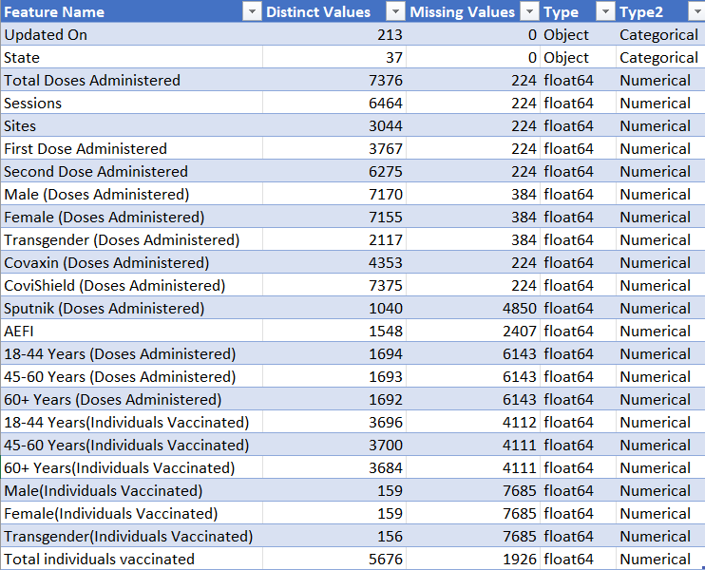
Feature Set Description
Department of Computer Science and Engineering,
KLE Technological University’s Dr. M. S. Sheshgiri College of Engineering and Technology, Belagavi

Slide 12
Proposed Hypothesis
1. How is the distribution of vaccine types represented across all states based on the total doses administered?
2. How is the distribution of Covaxin, Covishield and Sputnik V vaccine doses administered across all states of India ?
3. Which age group has received the highest number of vaccine doses, and how does vaccination coverage vary across different age groups?
4. Which gender group has received the highest number of vaccine doses across all States of India, and how does vaccination coverage vary across different gender groups?
5. What is the state-wise distribution of different age group individuals vaccinated?
6. Which state has the highest of total individuals vaccinated?
Department of Computer Science and Engineering,
KLE Technological University’s Dr. M. S. Sheshgiri College of Engineering and Technology, Belagavi

Slide 13
Proposed Hypothesis
7. Is there a significant difference between the number of first doses and second doses administered within each state?
8. Do states with higher numbers of sessions have lower rates of AEFI cases?
9. What is the relationship between the number of doses administered and the total number of individuals vaccinated across different states?
10.Which state has the highest covid-19 cases?
11.Is there a significant difference between the Total Doses Administered and Total Individuals Vaccinated within each state?
12. What is the loss of vaccine doses administered?
Department of Computer Science and Engineering,
KLE Technological University’s Dr. M. S. Sheshgiri College of Engineering and Technology, Belagavi

Slide 14
Proposed Hypothesis
13. What is covid-19 cases threat across different states?
14. What is the average number of doses administered per session?
15. What is the Distribution of Doses Administered by Vaccine Type and Gender ?
16. How are Doses Administered by Gender and Age Group ?
17. How many sessions were conducted in the whole vaccination process ?
18. Comparison of First and Second Dose Administration.
19. Is there any relation between adverse events following immunization (AEFI)
and the total number of vaccine doses administered ?
Department of Computer Science and Engineering,
KLE Technological University’s Dr. M. S. Sheshgiri College of Engineering and Technology, Belagavi

Slide 15
Implement Framework
Data Loading:
Dataset format: CSV
Load dataframe as data, using pandas library
Dataset type: Time Series
Data Cleaning:
Replace null values with median
Drop 3 attributes because of 97% null values
Drop 200 rows due to inconsistent data
Department of Computer Science and Engineering,
KLE Technological University’s Dr. M. S. Sheshgiri College of Engineering and Technology, Belagavi

Slide 16
Implement Framework
Data Exploration:
Calculated Central tendency measures
Calculate number of distinct values
Calculate Duplicate rows
Outlier Detection:
Boxplot to detect outliers
IQR method to handle Outliers
Department of Computer Science and Engineering,
KLE Technological University’s Dr. M. S. Sheshgiri College of Engineering and Technology, Belagavi

Slide 17
Implement Framework
Encoding Technique:
Applied label Encoding on ”Updated on” and ”States” Attributes to transform Categorical attributes to numerical attributes
Skewness and Normalization:
Calculated skew value and KDE plot to determine the skewness
Applied min-max normalization for model implementation
Department of Computer Science and Engineering,
KLE Technological University’s Dr. M. S. Sheshgiri College of Engineering and Technology, Belagavi

Slide 18
Implement Framework
Correlation Analysis:
Plot Heat map for Correlation Analysis
Data Visualization:
Donut Chart
Bar plot
Stacked bar plot
Multiple histogram
Gauge plot
Choreopleath map
Scatter plot
Department of Computer Science and Engineering,
KLE Technological University’s Dr. M. S. Sheshgiri College of Engineering and Technology, Belagavi

Slide 19
Implement Framework
Ridge Regression :is a type of linear regression that includes a regularization term. The regularization term helps to prevent overfitting by penalizing large coefficients in the model. This is particularly useful in scenarios where:
Mean Squared Error: 3.144815362054088e-05
R^2 Score: 0.9997321451240523
Root Mean Squared Error (RMSE): 0.005607865335449923
Coefficients: [0.27663828 0.06650932]
Intercept: 0.25323948944390806
Standard Deviation of Target Variable: 0.3427599332588373
RMSE as a percentage of Standard Deviation: 1.64%
Department of Computer Science and Engineering,
KLE Technological University’s Dr. M. S. Sheshgiri College of Engineering and Technology, Belagavi

Slide 20
MOOC Course Details
Team No. : EDA-B1
Div: B
Sl. No. | Name | SRN. | Course Name | Course Link | Status
1 | Akhilesh Joshi | 02FE22BCS013 | Python for Data Science , AI and Development | Coursera | Completed
2 | Dilipsingh Rajpurohit | 02FE22BCS035 | Python for Data Science , AI and Development | coursera | Completed
3 | Sana Mulla | 02FE22BCS099 | Python for Data Science (2023) | Udemy | Completed
4 | Seeba Doddmani | 02FE22BCS116 | Python for Data Science (2023) | Udemy | Completed
Department of Computer Science and Engineering,
KLE Technological University’s Dr. M. S. Sheshgiri College of Engineering and Technology, Belagavi

Slide 21
Thank you !
Department of Computer Science and Engineering,
KLE Technological University’s Dr. M. S. Sheshgiri College of Engineering and Technology, Belagavi

